Slide 1
Single Image Dehazing Using Multi-Scale Fusion
Team : Gold Diggers
Namratha Gopalabhatla (20171017, ECE)
Adhithya Arun (20171066, CSE)
Mentor : Prathyakshun Rajashankar
Repository URL : https://github.com/adhithyaarun/image-dehazing

Slide 2
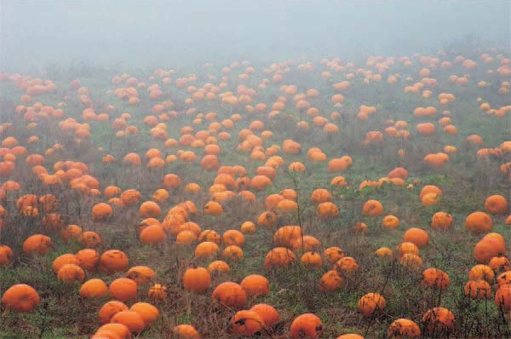
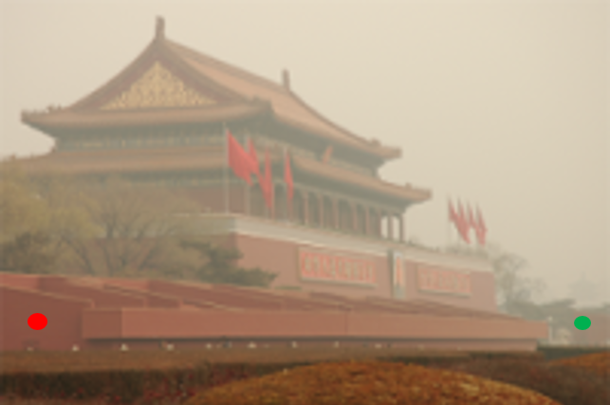
Problem Statement
The images in outdoor scenes are generally degraded by different weather condition. Atmospheric phenomena like fog and haze may degrade the visibility of the scene significantly.
We need to restore the image in the absence of the ground truth image, in a computationally inexpensive manner.

Slide 3
Understanding the problem
Due to the absorption and scattering, the light crossing the atmosphere is attenuated and dispersed. Therefore only a percentage of the reflected light reaches the observer, causing poor visibility in such degraded scenes. The light intensity I that reaches the observer is described by two main additive components: direct attenuation and veiling light.
I = J T (x) + V∞ (1 − T (x))
where J is the scene radiance or haze-free image, T is the transmission along the cone of vision and V∞ is the veiling color constant. We intend to find the above mentioned J.

Slide 4
Project objective:
Image Dehazing in Adverse Weather Conditions using a Single Image

Slide 5
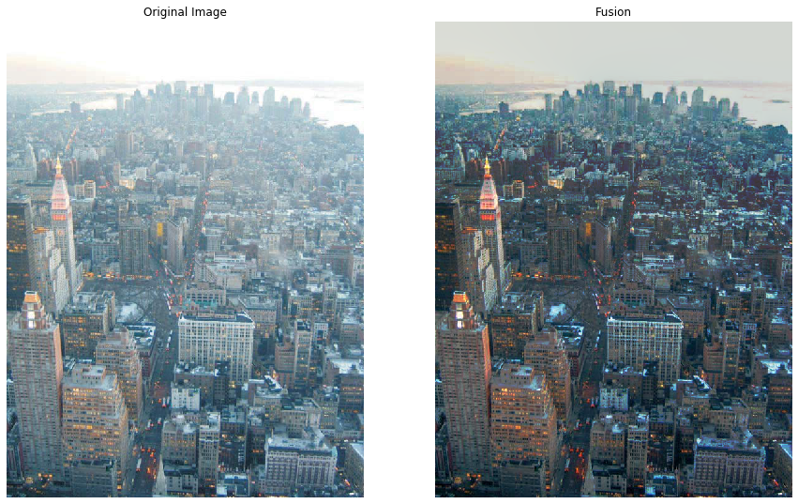
Implementation
The algorithm consists of three major steps :
Generation of input images
White Balanced Image
Contrast Enhanced Image
Generation of Weight Maps
Luminance Weight Maps
Chromatic Weight Maps
Saliency Weight Maps
Normalized Weight Maps
Multi Scale Fusion

Slide 6
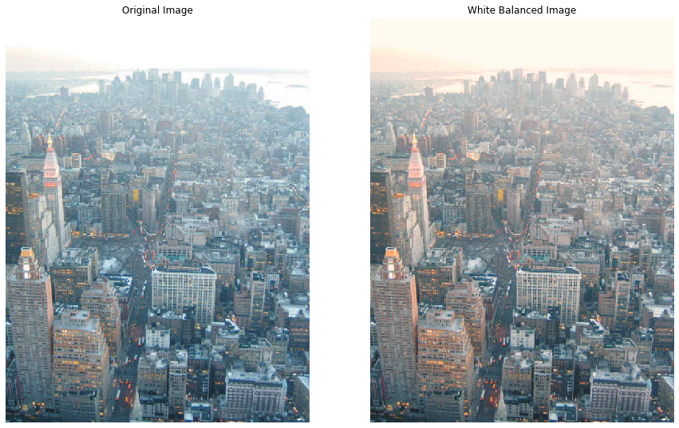
Generation of Input Images
White Balancing
The first input I₁ is obtained by white balancing the original hazy image. White balance step ensures the natural rendition of images by eliminating chromatic casts that are caused by the atmospheric color.

Slide 7
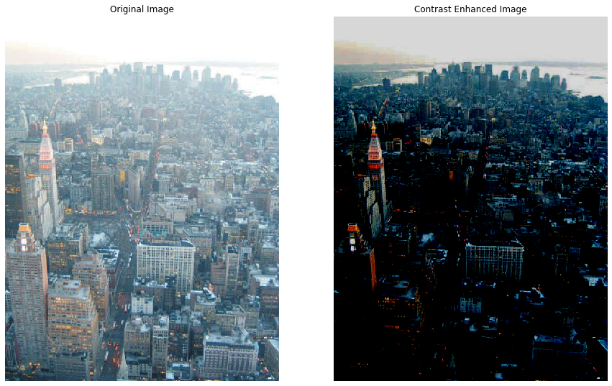
Contrast Enhancement
The second input I₂ is obtained by enhance the contrast of the image. The second input is selected in order to increase the contrast in hazy regions. This operation has the effect to amplify the visibility in regions degraded by haze.

Slide 8
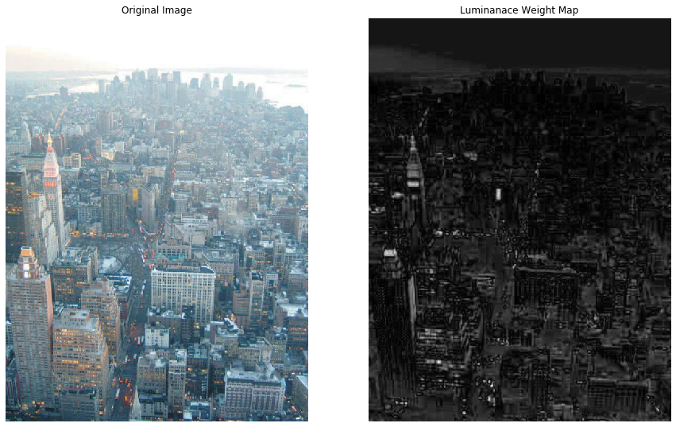
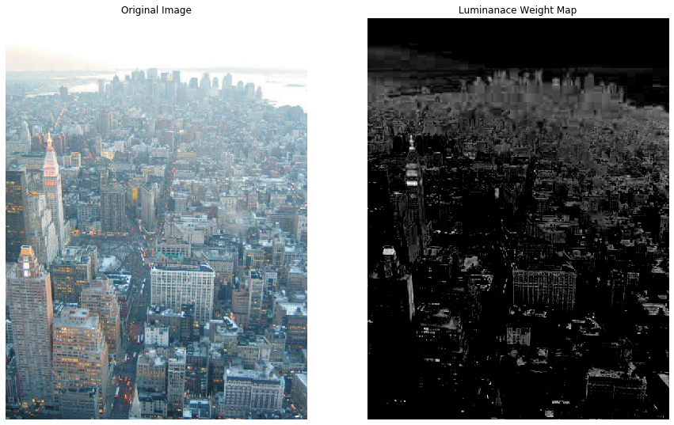
2. Generation of Weight Maps
Luminance Weight Map
Luminance weight map manages the luminance gain in the output image. This map computes the standard deviation between every R, G and B color channels and each pixel luminance L of the input.
Luminance Weight Map for I₁
Luminance Weight Map for I₂

Slide 9
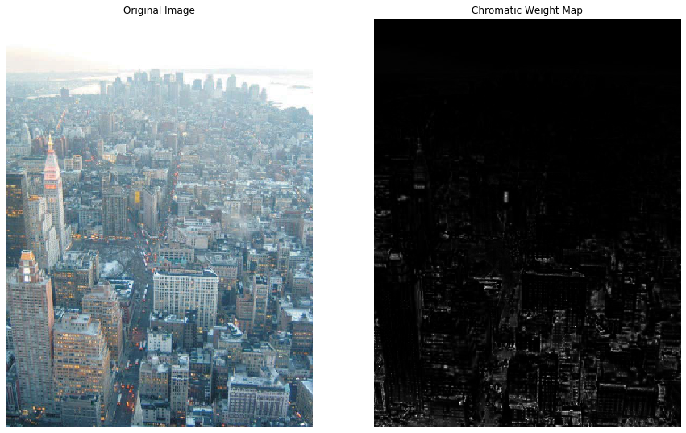
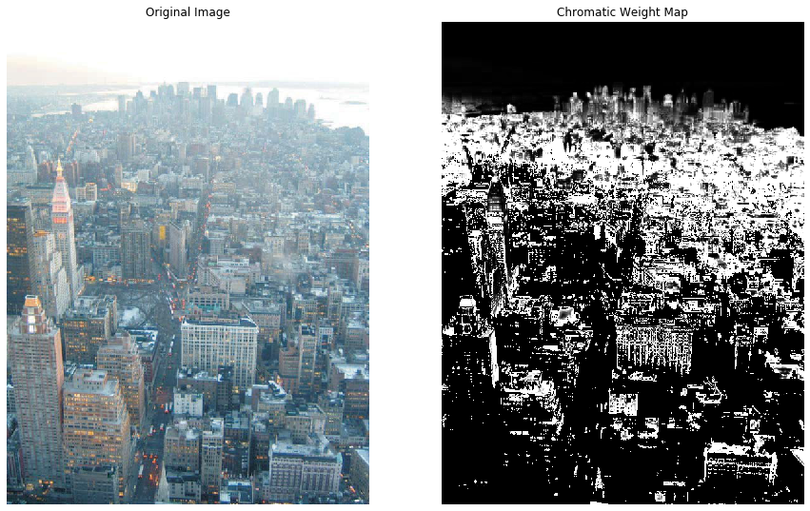
Chromatic Weight Map
Chromatic weight map controls the saturation gain in the output image. To obtain this map, for every pixel the distance between its saturation value S and the maximum of the saturation range is computed using a Gauss curve.
Distance = exp(-(S−Smax)²/ 2σ²)
Chromatic Weight Map for I₁
Chromatic Weight Map for I₂

Slide 10
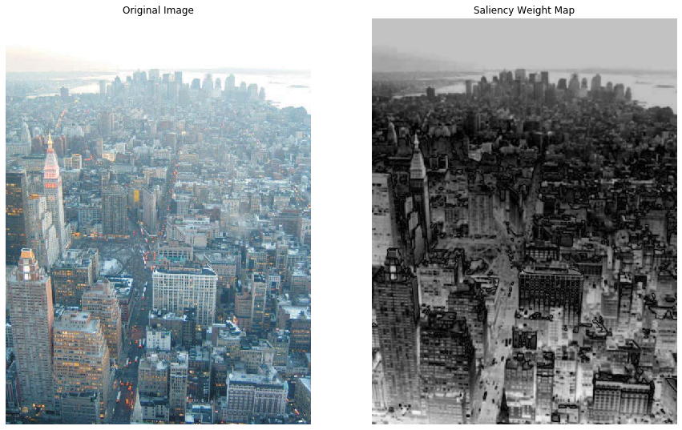
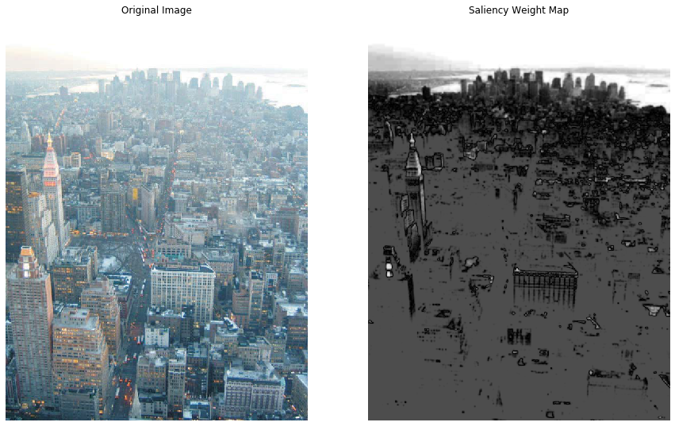
Saliency Weight Map
Saliency weight map identities the degree of conspicuousness with respect to the neighborhood regions. The idea for this is that the features in the image that standout, and hence the prominent feature will be clearly visible for the following formula :
S(x, y) = I(x, y) - gaussian_blur(I(x, y))
Saliency Weight Map for I₁
Saliency Weight Map for I₂

Slide 11
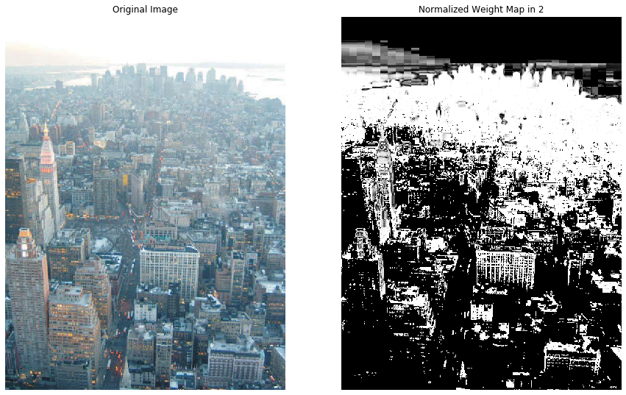
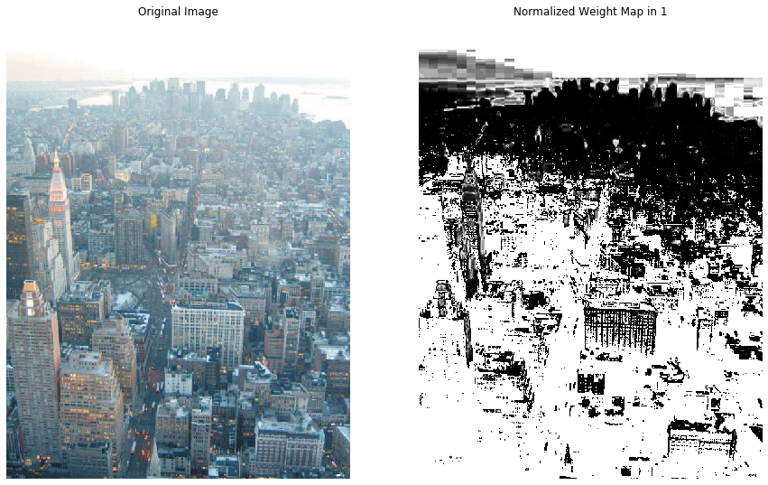
Normalized Weight Maps
We compute the 3 weight maps for each of the inputs and then for each of the input we compute the normalized weight map as :
weight_map(I) = saliency(I) * luminance(I) * chromatic(I)
normalized(I) = weight_map(I) / (weight_map(I₁) + weight_map(I₂))
where I = I₁ or I₂
Normalized Weight Map for I₁
Normalized Weight Map for I₂

Slide 12
3. Multi-Scale Fusion
In this process, the inputs I₁ and I₂ are weighted with certain weight maps so that we can extract only the significant features in the image.
Considering that both the Gaussian and Laplacian pyramids have the same number of levels, the mixing between the Laplacian inputs and Gaussian normalized weights is performed at each level independently yielding the fused pyramid.
F_{l}^{(i, j)} = Σ_{k} G_{l}{W’_{k}^{(i, j)}} L_{l}{I_{k}^{(i, j)}}

Slide 13
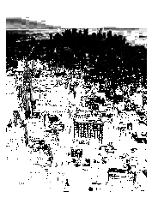
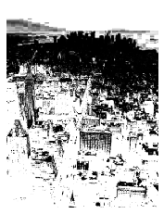
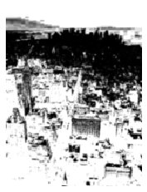
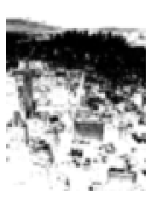
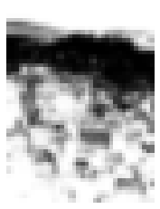
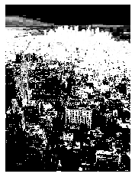
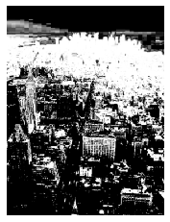
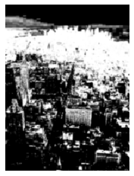
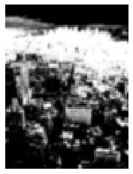
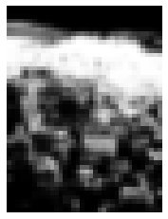
Gaussian Pyramids
The Gaussian pyramids are formed by forming the pyramid for each of the normalized weight maps.

Slide 14
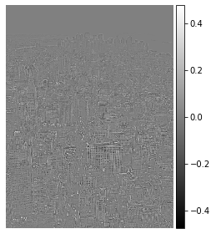
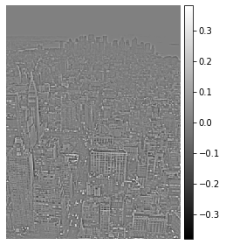
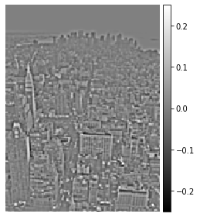
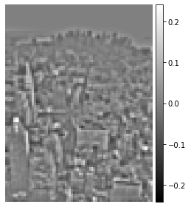
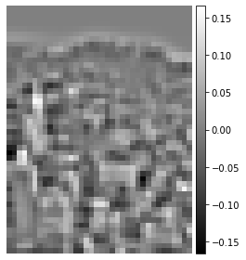
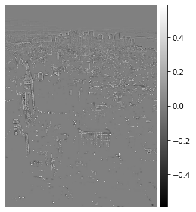
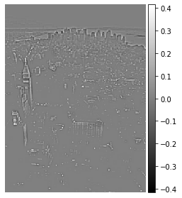
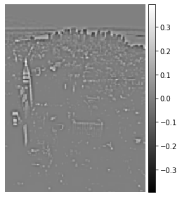
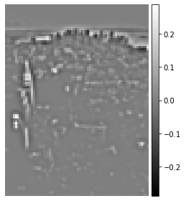
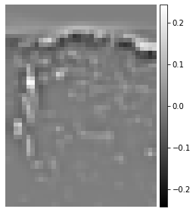
Laplacian Pyramids
The Laplacian pyramids are formed by forming the pyramid for each of two inputs by applying the Laplacian operator

Slide 15
Fusion of Pyramids
The fusion of the Gaussian and the Laplacian pyramids of each of the inputs, that is the white balances image and contrast enhanced image results in the final step of the algorithm.

Slide 16
Results

Slide 17
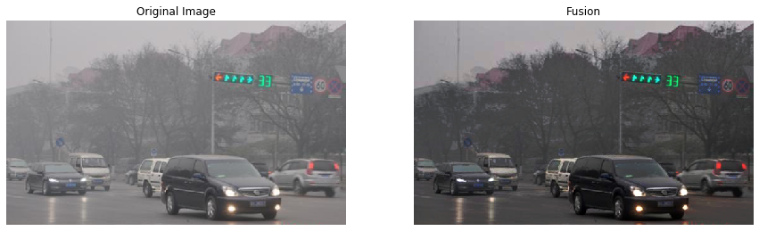

Slide 18
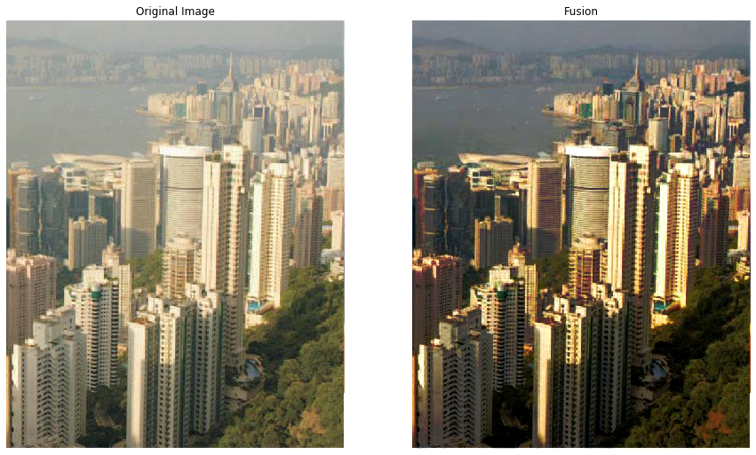

Slide 19
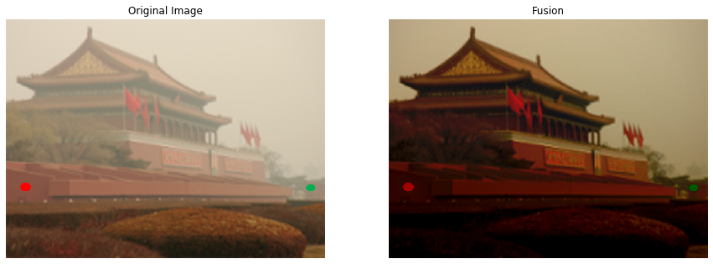

Slide 20
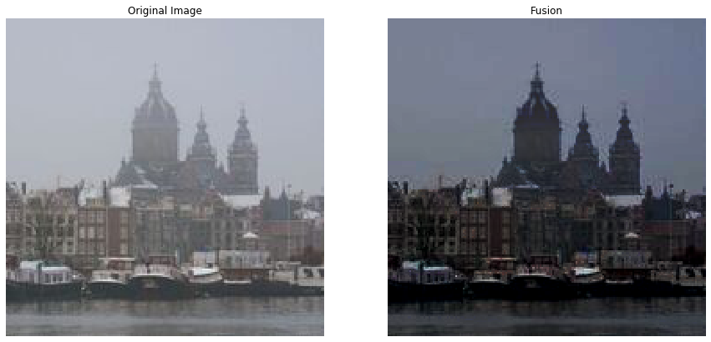

Slide 21
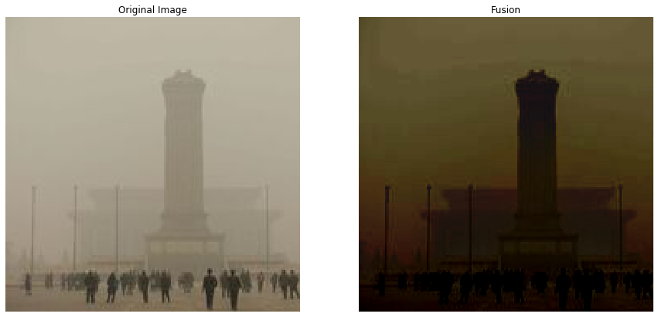

Slide 22
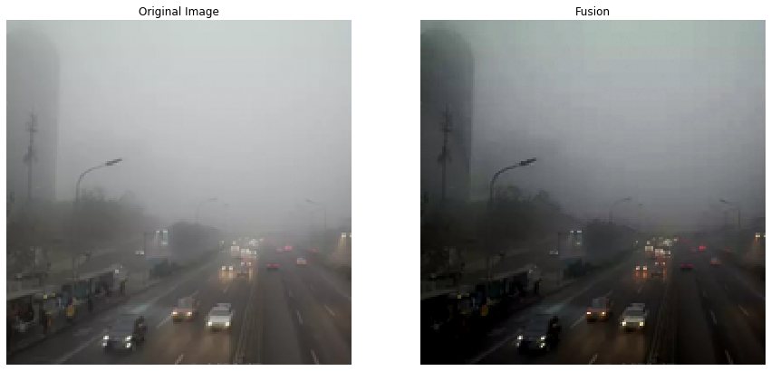

Slide 23
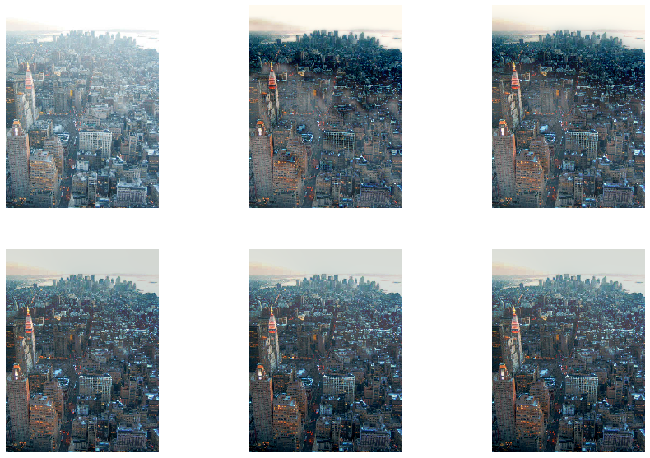
Variation with Height of Pyramids
Original Image
Pyramid Size: 3
Pyramid Size: 5
Pyramid Size: 8
Pyramid Size: 11
Pyramid Size: 15

Slide 24
Division of Work
Responsibility | Team Member
Generation of Input Images | Adhithya Arun
Generation of Weight Maps | Namratha Gopalabhatla
Generation of Image Pyramids | Namratha Gopalabhatla
Multi-Scale Fusion | Adhithya Arun
Analysis of Variation in Height of Pyramids | Namratha Gopalabhatla
Documentation | Adhithya Arun
Presentation | Adhithya Arun and Namratha Gopalabhatla

